Slide 1

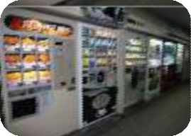
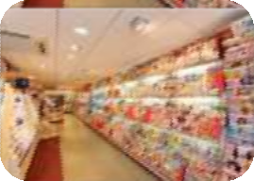

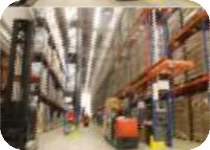
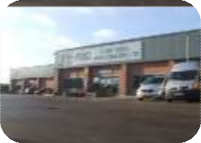
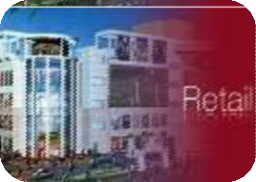


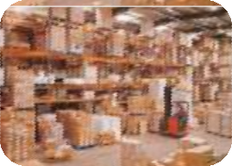

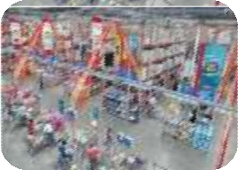
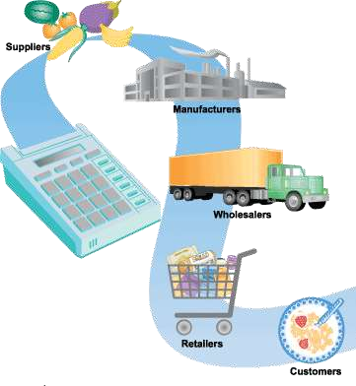
DELIVERING VALUE
“
we expanded the brand to include a whole line of
was not good to have one channel of distribution… “
Mujeeb TP
Asst. Professor ,Kottakkal Farook arts and science college
apparel and accessories, but we quickly learned that it
C
1

Slide 2

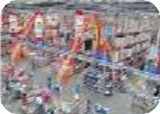
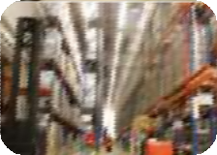
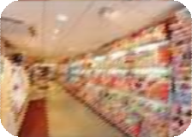
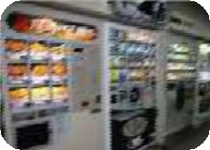

CONTENT
DESIGNING & MANAGING INTEGRATED MARKETING
CHANNELS
  Marketing Channels and Value Networks
  The Role of Marketing Channel
  Channel Design Decision
  Channel Management Decision
  Channel Integration & Systems
  Conflict, Cooperation & Competition
  E-Commerce Marketing Practices
MANAGING RETAILING, WHOLESALING & LOGISTICS
  Retailing
  Wholesaling
  Market Logistics
2

Slide 3
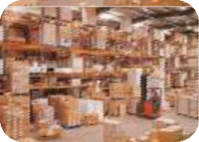

DESIGNING & MANAGING INTEGRATED MARKETING CHANNELS
3

Slide 4
MARKETING CHANNELS AND VALUE NETWORKS
Marketing Channel
“the set of firms and individuals that take title, or assist in transferring title, to a good or service as it moves from the producer to the final consumer or industrial user”
Kotler, P., and Armstrong (1989) Principles of Marketing. Prentice-Hall
4

Slide 5
Why It’s Important
MARKETING CHANNELS AND VALUE NETWORKS
Affect not only marketing decisions but also non-marketing’s
Convert potential buyers to profitable customers
Not only serve market but also make market
5

Slide 6
MARKETING CHANNELS AND VALUE NETWORKS
Marketing Channel Strategy
Push Strategy
Producer
inducing
Intermediaries
Consumer
When intermediaries can be persuaded to stock the product, in preference to those of competitors, then when customers visit a sales outlet and ask for a product by its generic name it is the product of the company which is supplied.
Pull Strategy
Producer
ordering
Intermediaries
Consumer
Creating such a strong preference for the product among end users that the
resulting demand pulls the product through the channel of distribution.
6

Slide 7




HYBRID CHANNEL
& MULTICHANNEL MARKETING
Multichannel Marketing
“marketing | using | many | different
marketing | channels | to | reach a
customer”
Rangaswamy, Arvind; Gerrit H. Van Bruggen (2005). Opportunities and challenges in multichannel marketing
PRODUCER
INTERMEDIARIES
CONSUMER
7

Slide 8

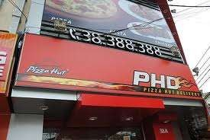

HYBRID CHANNEL
& MULTICHANNEL MARKETING
Channel Integration
“the merging of retail operations in such a manner that enables the transacting of a customer via many connected channels”
https://www.boundless.com/marketing/marketing-channels/marketing-channel- relationships/channel-integration/
ONLINE ORDER
OUTLET
DELIVERY
8

Slide 9
VALUE NETWORKS
Value Network
“a system of partnerships and alliances that a firm creates to source, augment and deliver its offerings”
Kotler, P., and Keller (2012) Marketing Management. Pearson Education Limited
May Includes
Suppliers
Customer
Consumer
Media
Etc.
9

Slide 10
THE ROLE OF MARKETING CHANNEL
Channel Function
Forward flow functions:
  From company to customers
  Develop / disseminate communication
  Store and move the physical products
  Oversee transfer of ownership
Backward flow functions:
  From customers to company
  Place orders with manufacturers
  Facilitate payment of bills
Forward and backward flow functions:
  Gather information
  Negotiate price and transfer of ownership
  Finance inventories
  Assume risk

Slide 11
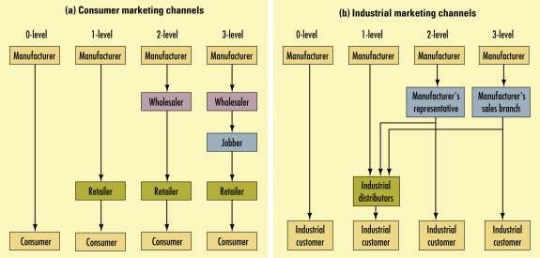

THE ROLE OF MARKETING CHANNEL
Channel Levels
Zero level channel
One level channel
Two level channel
Three level channel

Slide 12

THE ROLE OF MARKETING CHANNEL
Service Sector Channel
Service sector channels use agencies and locations to access population to be served
Banking
Insurance
Travel
“Kodak offers its customers four ways to print their digital photos-minilabs in retail outlets, home printers, online services at its Ofoto Website, and self-services kiosks. The world leader with 80.000 kiosks, Kodak makes money both by selling the units and by supplying the chemical and paper they use to make the prints.”

Slide 13
CHANNEL DESIGN DECISIONS
Designing A Channel System Requires…
Analyzing consumer needs
Setting channel objectives
Identifying major channel alternatives
Evaluation

Slide 14










Analyzing Consumer Needs And Wants
LOT SIZE - the number of units the channel permits a typical customer to purchase on one occasion.
WAITING AND DELIVERY TIME - the average time customers wait for receipt of goods. costumer increasingly prefer faster delivery channels.
SPATIAL CONVENIENCE - the degree to which the marketing channel makes It easy for customers to purchase the product.
PRODUCT VARIETY - the assortment provided by the marketing
channel.
SERVICE BACKUP - add on services (Credit, delivery, installation, repairs) provided by the channel. the greater the service
the greater the work provided by the channel.
backup
,

Slide 15

Establishing Objectives and Constraints
Purpose:
In order to develop channel structure, manager should decide some goals trying to be achieved.
These goals must be in line with some other component of marketing mix, to anticipate collision among them.
These goals must be congruent with marketing and other general objectives and strategies of the firm

Slide 16














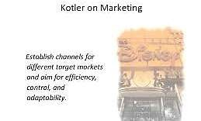
IDENTIFYING MAJOR CHANNEL ALTERNATIVES
TYPES OF INTERMEDIARIES
Number of Intermediaries
  Exclusive distribution
  Selective Distribution
  Intensive Distribution
Terms and Responsibilities of Channel Members

Slide 17
EVALUATING
Evaluation Criteria…
Economic criteria compares the likely sales costs and profitability of different channel members
Control refers to channel members’ control over the marketing of the product
Adaptive criteria refers to the ability to remain flexible to adapt to environmental changes

Slide 18
CHANNEL MANAGEMENT DECISION
What Company Should Do…
Selecting channel members
Training channel members
Motivating channel members
Evaluating channel members
Modifying channel arrangements
Considering global expansion

Slide 19
CHANNEL INTEGRATION & SYSTEM
Vertical marketing systems
  Corporate VMS
  Administered VMS
  Contractual VMS
Horizontal marketing systems
Multichannel marketing systems

Slide 20

CONFLICT, COOPERATION & COMPETITION
Conflict happens when an action by a channel member prevent the other member to achieve its goal.
Channel Coordination occurs when channel members are brought together to advance the goals of the channel, as opposed to their own potentially incompatible goals.

Slide 21

CONFLICT, COOPERATION & COMPETITION
Type of conflicts:
  Vertical Conflict
“Conflicts between different levels within the same channel”
  Horizontal Conflict
“Conflicts between same levels within the different channel”
  Multi-Channel Conflict “Conflicts when multiple channels are employed and all
sell to same market

Slide 22
CONFLICT, COOPERATION & COMPETITION
Goal Incompatibility
Unclear Roles & Rights
Cause of
Conflict
Differences In
Perceptions
Intermediaries’ Dependence On The Manufacturer

Slide 23
CONFLICT, COOPERATION & COMPETITION
Managing channel conflicts:
  Strategic Justification
  Dual Compensation
  Superordinate Goals
  Employee Exchange
  Joint Membership

Slide 24
CONFLICT, COOPERATION & COMPETITION
Managing channel conflicts:
  Co-optation
“an effort by one organization to win the support of the leaders of the another by including them in advisory councils, BoD, etc.”
  Diplomacy
“process when each side sends a person or
group to meet it counterparts.”
  Mediation
“process that relies on another 3rd party skilled in conciliatin the two parties’ interest”

Slide 25
CONFLICT, COOPERATION & COMPETITION
Managing channel conflicts:
  Arbitration
“process where two parties agree to present their arguments to one or more arbitrators and accept their decision”
  Legal Recourse
“process to manage the conflict that involving
law suits”

Slide 26

CONFLICT, COOPERATION & COMPETITION
Dilution and Cannibalization
Happens mostly on luxury brands that has its brand image built based on exclusivity and services that customized based on
customer’s need.
Their brand image will be “downgraded” if they sell to much in a discounted channel.

Slide 27

CONFLICT, COOPERATION & COMPETITION
Legal and Ethical Issues in Channel Relations:
Exclusive Distribution
Exclusive dealing
Tying agreements

Slide 28
E-COMMERCE
E-commerce
“a website providing or enabling an individual to do transactions online”
OR
“a way to sell or shop online or direct selling that utilize Internet on a website providing get & deliver service”

Slide 29
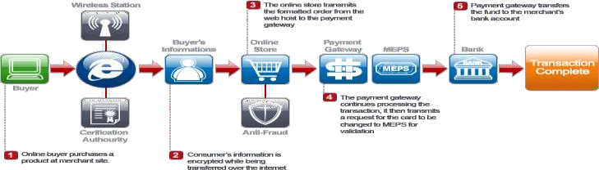
E-COMMERCE
E-commerce in general
  E-Purchasing
  E-Marketing
E-Commerce type
  Pure click
  Brick n Click

Slide 30
MANAGING RETAILING, WHOLESALING & LOGISTICS

Slide 31


RETAILING
Retailers
“all the activities involved in selling goods or services directly to final consumers for personal, nonbusiness use”
Kotler, P., and Keller (2012) Marketing Management. Pearson Education Limited

Slide 32
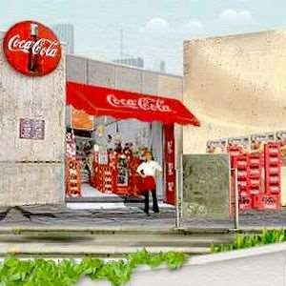
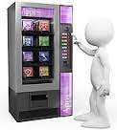
RETAILING
Types of Retailers
Store Retailers
Specialty store
Department store
Supermarket
Convenience store
Discount store
Off-price retailer
Superstore
Catalog showroom
Non-Store Retailers
  Direct selling
  Direct marketing
  Automatic vending
  Buying service

Slide 33
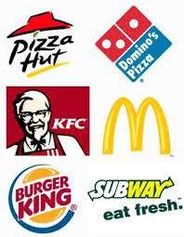
RETAILING
Types of Retailers
Corporate Retail & Franchise
Corporate chain store
Voluntary chain
Retailer cooperative
Consumer cooperative
Franchise organization
Merchandising conglomerate

Slide 34

MARKETING DECISIONS IN RETAILING
Decisions Areas
Target market
Product assortment
Procurement
Prices
Services

Slide 35
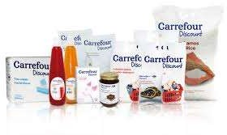
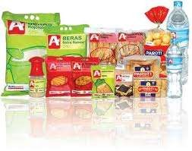
PRIVATE LABELS
Private Labels
“brand owned not by a manufacturer or producer but by a retailer or supplier who gets its goods made by a contract manufacturer under its own label”
http://www.businessdictionary.com/definition/private-label.html

Slide 36
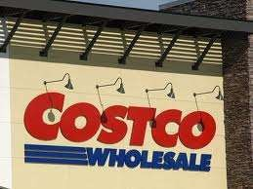
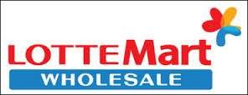
WHOLESALING
Wholesalers
“the middlemen who operates between the producers (from whom they purchase goods) and the retailers (to whom they sell goods).”
http://business.gov.in/manage_business/wholesalers_retailers.php

Slide 37
WHOLESALING
Wholesalers Types
Merchant Wholesaler
Full-service Wholesaler
Limited-service Wholesaler
Broker and Agents
Manufacturers and Retailers Branches & Offices
Specialized Wholesalers
Wholesalers Functions
Selling & Promoting
Assortment Building
Bulk Breaking
Warehousing
Transporting
Financing
Risk Bearing
Market Information
Management Services & Advice
37

Slide 38
MARKET LOGISTIC
Market Logistic
“planning, controlling
implementing, and the physical flows of
materials and final goods from points of origin to points of use to meet customer requirements at a profit”
Kotler, P., and Armstrong (1989) Principles of Marketing. Prentice-Hall

Slide 39




MARKET LOGISTIC
Market Logistic Decisions
How should orders be handled?
Where should stock be located?
How much stock should be held?
How should goods be shipped?
Order Processing
Warehousing
MARKET LOGISTIC
Transportation
Inventory

Slide 40
CONCLUSION
Most producers use channels to market their product.
Effective management should include selection, training and motivating g channel members.
All channels have potential to conflict and should be
managed well.
Channel selection should consider legal issues.
E-commerce and other ICT areas are still growing and can be explored for marketing.
It should be considered to use retail, wholesaling or
both channel.
Marketing logistic is on importance decision related to marketing channels.

Slide 41
Thank You

