Slide 1
MARKETING MANAGEMENT
Mujeeb t p.
Asst. professor
Kottakkal Farook arts & science college

Slide 2
Packaging
Activities of wrapping or enclosing the product in a container like bottle, tin, jar, bag etc to facilitate transportation, storage, sale or consumption
Functions of Packaging (Objects, Need)
Protection
Convenience
Promotion
Identification
Helps in branding
information

Slide 3
Labelling
An informative tag, wrapper or seal attached to a product or product’s package

Slide 4
Branding
Naming a product for its identification and distinction
Brand
Brand Name
Brand Mark
Branding
Trade Mark

Slide 5
Types of Brands
Manufacturer brands
Private distributor brand
Generic brand
Family brand
Individual brand
Licensed brand
Co - brand

Slide 6
Brand Loyalty
The loyalty of a buyer towards a particular brand
Strong attachment of buyer towards a particular brand
Brand Equity
Value associated with a brand
Set of asset and liabilities linked to a brand’s name and symbol that add to or subtract from the value provided by a product or service to a firm and that firm’s customers.

Slide 7
Product life cycle
It describes the stages a product goes through from when it was first thought of until it finally is removed from the market. Not all products reach this final stage. Some continue to grow and others rise and fall
Product passes through different stages

Slide 8
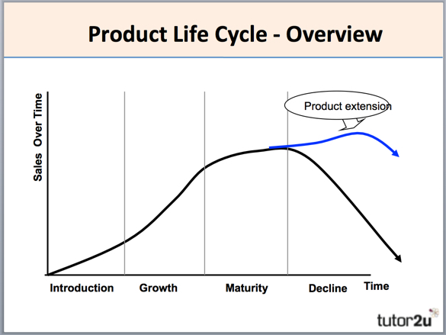
Introduction
Growth
Maturity
Decline

Slide 9
Warranty and Guarantee
warranty: "a written guarantee promising to repair or replace an article if necessary within a specified period." ... A warranty is a type of guarantee; in the case of a product guarantee/product warranty, it's basically the same thing - the company undertakes to repair or replace your goods if they go wrong

Slide 10
Marketing Myopia
Lack of foresight may causes failure of business. This short-sighted, narrow minded view of marketing.

Slide 11
Pricing
The amount paid by the buyer to the seller for a product.
Exchange value of a product or service in the terms of money.

Slide 12
Steps in setting the price
Studying target market
Selecting the pricing objectives
Determining demand
Estimating cost
Analysing prices of competitors
Selecting the pricing method
Selecting the final price

Slide 13
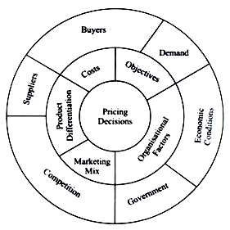
Factors influencing pricing decisions
The influencing factors for a price decision can be divided into two groups
(A) Internal Factors and
(B) External Factors.

Slide 14
Methods of pricing
Cost based pricing policy
Cost + Pricing
Target Pricing
Marginal Cost pricing
Break event pricing
Demand based pricing policy
Differential pricing
Premium pricing
Competition based pricing policy
Going rate pricing
Customary or conventional

Slide 15
Strategies or Methods of Pricing of new product
Skimming Pricing policy
High initial price charged when a new product is introduced in the market
Penetration Pricing Policy
Low price charged when a new product is introduced in the market
Steps in Pricing policy
Selecting target market
Studying consumer behaviour
Identifying competition
Assigning price a role in the marketing mix
Relating Cost and demand
Determining the strategic price

Slide 16
Important pricing strategies
Psychological pricing
Geographical pricing
Base point pricing
Zone pricing
Dual pricing
Administered pricing
Mark – up pricing
Product line pricing
Captive pricing
Price bundling

Slide 17
Price adjustment Strategies
Discount pricing and allowances
Discriminatory pricing
psychological pricing
Promotional pricing
Value pricing
International pricing

Slide 18
Thank You

